Slide 1
Secure RESTful Interface Profile Pilot Overview Briefing
Approved for Public Release; Distribution Unlimited. Case Number 15-0133
The MITRE Corporation
January 6, 2015

Slide 2
Outline
Task Overview
Secure REST Interface Profiles
Secure REST Interface Pilot Motivation
Why Build a Pilot?
Pilot Goals
Security Patterns and Use Cases
Pilot Implementation
Summary
Components
Storyboard
Architecture and Tools
Findings
Next Steps
Connections to Related Efforts
For More Information

Slide 3
Task Background
In 2014, the US Department of Veterans Affairs (VA) asked MITRE to design an approach to securing RESTful interfaces:
Using open standards
Compliant with VA security requirements
Supporting lightweight web clients and mobile devices
Sponsor: VA Office of Information & Technology (OI&T) Architecture, Strategy, and Design division (ASD)
MITRE produced universal security guidance and standards profiles for OAuth and OpenID Connect
Profiles address fundamentals of securing authentication and authorization of RESTful requests
Use-case agnostic and applicable to a wide range of interfaces
Suitable for health information, but equally applicable to other domains
Suitable for VA use, but equally applicable to other organizations
Include optional, advanced security measures suitable for highly sensitive use cases
MITRE is validating these profiles with a pilot implementation

Slide 4
Secure REST Profile Pilot Team
Task Technical Team
Mark Russell, MITRE Cyber Security Technical Center
Justin Richer, MITRE Information Technology Technical Center
Dave Hill, MITRE Open Health Services Department
Sponsor Point of Contact: Mike Dowe, MITRE Center for Veteran Enterprise Transformation
Outcome Lead: Mary Pulvermacher, MITRE Information Technology Technical Center

Slide 5
Secure RESTful Interface Profile Task Overview
Mar-May
Jun-Aug
Dec-Jan 2015
Sept-Nov
Define Approach
Document REST Security Patterns
Focus on how to secure the interfaces
Build on prior work
16 May: Business oriented use cases & security requirements
12 Jun: Secure RESTful Interace Profile Approach
28 Jul: Secure RESTful Interface Security Analysis and Guidance
Develop profiles
OAuth 2
OpenID Connect
30 Jun: OAuth 2 profile v1.0
30 Jun: OpenID Connect profile v1.0
Validate profiles
Pilot use of profiles
Capture lessons learned
Update profiles
Open source software: 19 Dec
Lessons Learned: 19 Dec
Profiles updates: 12 Jan
Perform Outreach
15 Aug: Overview to ESS Working Group
15 Aug: Draft profiles to VHA Privacy on FHIR lead for feedback
15 Aug: Draft profiles to Healthcare Services Platform Consortium (HSPC)
Scheduled
Paper delivered
Briefing delivered
Code delivered

Slide 6


Building on Prior Work
RESTful Health Exchange:
An open source, exploratory project to apply proven web technologies to demonstrate a simple, secure, and standards-based health information exchange.
Demonstrated use of a RESTful interface to health data, using OpenID and OAuth to provide distributed authentication and authorization.
http://wiki.siframework.org/RHEx
BlueButton+ Pull
Demonstrated the use of OAuth to allow a patient to authorize a trusted software client to access EHR data.
http://wiki.siframework.org/BlueButton+Plus+Initiative
These efforts demonstrated the viability of RESTful interfaces protected by OAuth and OpenID Connect to serve specific health use cases.
The Secure RESTful Interface Profile provides general, comprehensive REST security guidance that can be applied to different kinds of use cases.

Slide 7
Standards and Profiles
Standards have varying degrees of specificity
“Loose” standards have many optional components
Can be widely applicable to different use cases, at the expense of interoperability and often security
Profiles impose constraints on a standard to obtain required interoperability and/or security for a given use case
Lock down standards (e.g., turn SHOULDs and MAYs into MUSTs)
Specify an allowed subset of implementation options
Incorporate security guidance documents (e.g., RFC6819 – “OAuth 2.0 Threat Model and Security Considerations”) and countermeasures for known attacks
OAuth is a particularly loose standard
Called an “authorization framework” rather than a “protocol”
See example on next chart

Slide 8
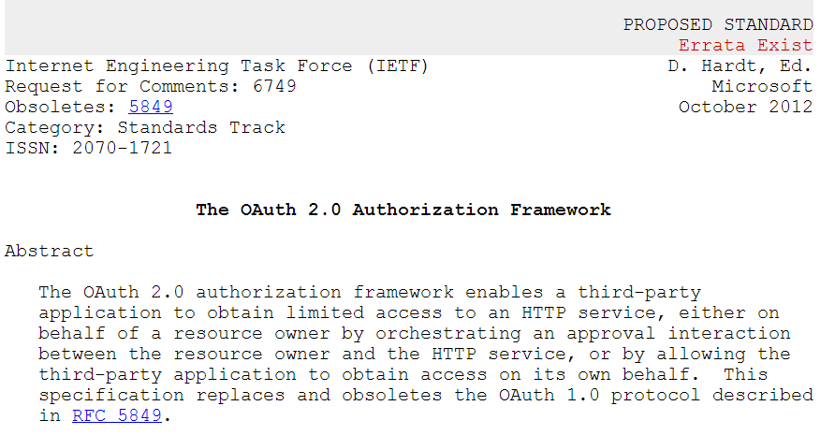
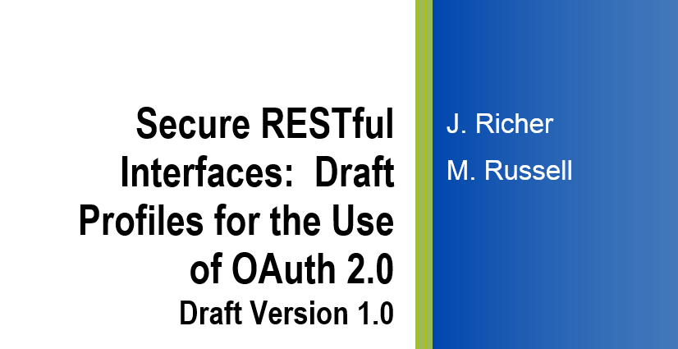
Profiling Security Standards – Examples from the OAuth 2.0 Profile
The authorization server SHOULD require all clients to register their
redirection endpoint prior to utilizing the authorization endpoint.
The authorization server SHOULD require the client to provide the
complete redirection URI
An access token is a string representing an authorization issued to the client. The string is usually opaque to the client.
…
Access tokens can have different formats, structures, and methods of utilization (e.g., cryptographic properties) based on the resource server security requirements.
The server MUST issue tokens as JWTs with, at minimum, the following claims…
The access tokens MUST be signed with JSON Web Signature (JWS). The authorization server MUST support the RS256 signature method for tokens and MAY use other asymmetric signing methods.
RFC6749 – The OAuth 2.0
Authorization Framework
Clients using the authorization code or implicit grant types MUST register their full redirect URIs. The Authorization Server MUST validate the redirect URI given by the client at the authorization endpoint using strict string comparison.
Secure RESTful Interface
Profiles for OAuth 2.0

Slide 9
Profiling Security Standards – Examples from the OAuth 2.0 Profile
An access token is a string representing an authorization issued to the client. The string is usually opaque to the client.
…
Access tokens can have different formats, structures, and methods of utilization (e.g., cryptographic properties) based on the resource server security requirements.
RFC6749 – The OAuth 2.0
Authorization Framework
The server MUST issue tokens as JWTs with, at minimum, the following claims…
The access tokens MUST be signed with JSON Web Signature (JWS). The authorization server MUST support the RS256 signature method for tokens and MAY use other asymmetric signing methods.
Secure RESTful Interface
Profiles for OAuth 2.0

Slide 10
Why build a pilot?
Existence proof
Show a standard’s feasibility and applicability by building it
Provide demonstration code
Hands-on experience
How easy are the profiles to implement?
What is the state of software library support?
The importance of running code
A standard isn’t a real standard until multiple parties are using it

Slide 11







Life of a Profile re: Open REST Security Standards
We are here
We are here
Leverage
Draft Profiles
Create
Vet
Validate
Engage
Community
Validate
Share
Pilot
Publish
Adopt and Use
Use
Influence next generation of standards and profiles

Slide 12
Pilot Goals
Open source implementation
Maximize reuse of existing open source components
Validate open security standards profiles usefulness, completeness, and ease of implementation
Assess the capabilities of existing server software and client libraries to implement the profiles
See what functionality already exists
Identify gaps
Exercise VA REST Security Patterns
Demonstrate delegated client authorization and identity federation (on both the identity provider and relying party sides)
Demonstrate VA value
Demonstrate how the REST security patterns can support VA’s mission of providing care to veterans

Slide 13
RESTful Security Patterns / Pilot Use Cases
Identity Federation: VA as Relying Party (RP)
Show how to accept external identities over OpenID Connect 1.0
Enables cross-domain access without requiring participants to maintain passwords with each site
Identity Federation: VA as Identity Provider (IdP)
Show how VA can securely assert its users’ identity information to external partner applications using OpenID Connect 1.0
Client Delegated Authorization (Cross-domain rights delegation)
Show how a patient can get access to their record in an app using OAuth 2.0
Show how clients can access resources securely across domains
Show how a doctor can pull a patient’s information from a remote provider
Show how OAuth scopes can be used to limit access to particular FHIR resources

Slide 14
Pilot Scenario Mapped to RESTful Security Patterns
Scenario | Pattern(s) illustrated
Steve, a veteran, is able to link his medical record at VA to an account with his external IdP, and can use it to access a VA web portal | Federated authentication (VA as RP)
Steve delegates access to his VA health records to a health tracking web app | Delegated authorization Federated authentication (VA as RP)
While on vacation, Steve has an accident and visits an external (non-VA) ER, and is able to delegate access to his VA records to the ER system | Delegated authorization Federated authentication (VA as RP, ER as RP)
Steve’s VA doctor is able to access Steve’s records at the ER and transfer the relevant information to his VA medical record | Delegated authorization Federated authentication (VA as IdP, ER as RP)

Slide 15
Pilot Implementation Summary
Demonstrates secure RESTful exchange
Using lightweight, scalable, open standards widely used on the WWW today (REST, JSON, OAuth, OpenID Connect)
Validates open source security profiles
Exchanges data using FHIR (Fast Healthcare Interoperability Resources)
Rapidly emerging standard for health data exchange www.hl7.org/fhir
Uses Veteran Steve scenario
Shows that Steve can access his health records and authorize others (physicians, apps) to do so
Has three separate security domains

Slide 16
Pilot Implementation: Using and extending open source software
Leverages prior MITRE open source projects:
MITREid Connect - An open source reference implementation of OpenID Connect and OAuth 2.0 from the MITRE Corporation and MIT Kerberos and Internet Trust (KIT)
VistA Novo - an open source VistA developer toolkit, providing a FHIR implementation and a test stub
Leverages existing open source libraries
OmniAuth – a Ruby authentication framework supporting OAuth and OpenID Connect; required some modifications to be able to support the profiles
Nimbus JOSE+JWT - Java library that implements the Javascript Object Signing and Encryption (JOSE) spec suite and the closely related JSON Web Token (JWT) spec
All code written for the pilot is open source and available on GitHub

Slide 17
Pilot Implementation Three separate security domains
Patient
Primary Provider
(VA)
Secondary Provider
(ER)

Slide 18


Meet Steve
Patient
Steve delegates access to VA health records to health tracking web app
Steve can access his VA record through the VA systems using his own digital identity
While on vacation, Steve has an accident; visits local (non-VA) ER
Steve’s
VA
EHR
Medical History
Steve’s
ER
EHR
Care Results
VA
ER

Slide 19
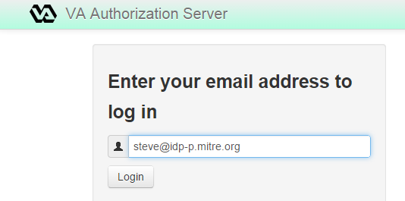
Storyboard 1: Steve uses his personal account to log into VA systems
Patient
Log in
example.com
identity provider
Steve logs into a VA system with his existing account at example.com, a public identity provider, instead of creating a new account at VA
Steve
Identity info
Steve’s
VA
EHR
VA
ER

Slide 20
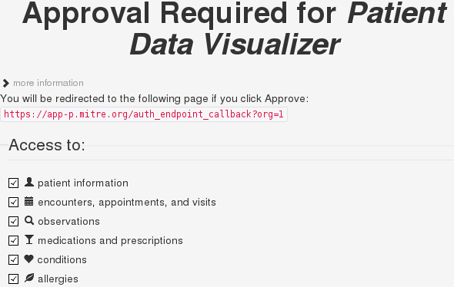
Storyboard 2: Steve Connects his mobile app to his Data
Patient
Steve authorizes his mobile client to access certain elements ("scopes“, which correspond to FHIR resources) of his medical record. This authorization is temporary and can be revoked at any time, and doesn't require exposing Steve's credentials to the client.
Health Tracking
App
Authorization
EHR Data (FHIR Resources)
Steve’s
VA
EHR
VA
ER

Slide 21
Plot point: Car Accident
While on vacation, Steve has a car accident and is taken by ambulance to an external (non-VA) emergency room
ER

Slide 22
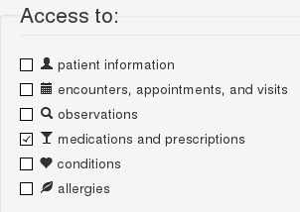

Storyboard 3: Steve links his new ER records to his VA records
Patient
The ER doctor (Dr. Pellegrino) has questions about what medications Steve takes. Steve is able to log into the ER’s EHR system using his personal account (as in Storyboard 1). Steve authorizes the ER system to access the medications portion of his VA record. Dr. Pellegrino can now access the imported medication data without seeing the rest of Steve's records.
Log in
Steve
Identity info
Authorization
Steve’s
VA
EHR
Steve’s
ER
EHR
Medications
Dr. Sam Pellegrino
VA
ER

Slide 23
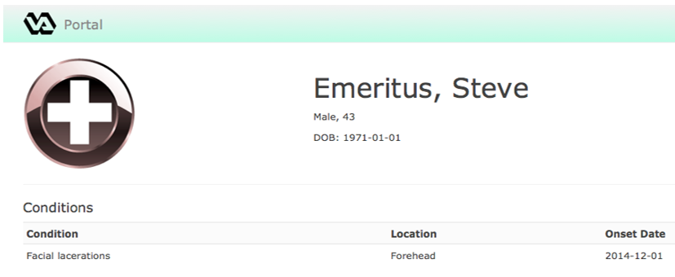
Storyboard 4: VA Doctor accesses ER records
Patient
When Steve returns to see his VA doctor, Dr. Feelgood is able to access information about Steve’s injuries and treatment in the ER’s EHR system and update Steve’s VA records.
Steve
Steve’s
VA
EHR
Steve’s
ER
EHR
Condition information
Log in
Identity info
Dr. Pat Feelgood
Dr. Sam Pellegrino
VA
ER

Slide 24
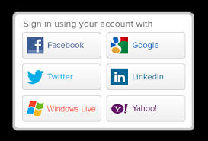
Not shown – Linking Steve’s personal account to his medical records
The pilot demonstrates Federated login using OpenID Connect, but doesn’t show how Steve’s example.com account is authorized to access his medical record
Steve could demonstrate ownership of his example.com account by logging into it during his registration at the VA or ER
This requires the FHIR server to have a mechanism for registering an external account as an authorized account belonging to the patient
The NSTIC AAMVA* pilot with INOVA Fairfax Hospital demonstrates the use of external patient credentials to access medical data
http://himss.files.cms-plus.com/2014Conference/handouts/78.pdf
* American Association of Motor Vehicle Administrators

Slide 25

Not shown – Authorizing users to access resources across domains
The pilot demonstrates Federated login using OpenID Connect, and OAuth authorization of a FHIR client in one domain to access resources in another.
Steve’s VA doctor is explicitly granted access by name to his ER record.
User-Managed Access (UMA) can enable more robust, policy-based, user-defined access controls over data without having to define rules in each data store
E.g., authorizing any physician or lab technician who is authorized to his ER files to access his VA files
UMA was not mature enough to profile and demo for this effort
The OpenID Foundation’s Health Relationship Trust (HEART) working group is working towards UMA profiles for this type of use case

Slide 26
Not shown – Ingesting EHR data from external sources
Steve’s VA doctor imports data from the ER’s EHR system in to VA’s EHR system
Technically it would be possible today for two EHR systems to share medical data across domains as FHIR resources
Difficult policy questions must be resolved before this can become a practical reality, including:
Persistence – whether data obtained from external sources should be stored natively in the receiving EHR, a PHR, or some other repository
Provenance – how to maintain linkage of data to the external source from which it was obtained
Data usage policies – how data can be used based on provenance information
(e.g., data from some sources may not be used in diagnostics)

Slide 27
Pilot Implementation Components
IdP
AS
Client
Server
Patient
Identity Provider (IdP)
FHIR Client
Identity Provider (IdP)
Identity Provider (IdP)
Authorization Server (AS)
Authorization Server (AS)
FHIR Client
FHIR Client
VA
FHIR Server
FHIR Server
ER

Slide 28
Patient Domain
IdP
AS
Client
Server
Patient
idp-p
app-p
Services trusted by the patient
Run by the patient
Service purchased by the patient
Service made available to the patient
Mobile health application
Web site with a FHIR client that can read from and aggregate data from multiple domains
Personal identity provider
Provides identity for the patient
VA
ER

Slide 29
Healthcare Domains
IdP
AS
Client
Server
Patient
idp-p
app-p
Identity provider
Provides identity for doctors/staff inside healthcare provider
idp-va
as-va
Authorization server
Protects APIs within the domain
ehr-va
FHIR server
Patient records
Protected by domain authorization server
VA

Slide 30
Components: FHIR clients
IdP
AS
Client
Server
Patient
User-facing data display
User can connect to multiple FHIR records
Authenticates with OpenID Connect
Patient domain: Patient only
Provider domains: Any user
VA
ER

Slide 31
Components: FHIR servers
IdP
AS
Client
Server
Patient
Determines which users (across domains) have access to which records
Accepts OAuth tokens from local authorization server only
Serves records local to the domain only
VA
ER

Slide 32
Components: Identity Providers
IdP
AS
Client
Server
Patient
Software: MITREid Connect
https://github.com/mitreid-connect/
Provides OpenID Connect identities
Does not provide API authorization
Direct log-in local accounts only
VA
ER

Slide 33
Components: Authorization Servers
IdP
AS
Client
Server
Patient
Software: MITREid Connect
https://github.com/mitreid-connect/
Provides OAuth authorization capabilities
Supports both clients and protected resources
Allows logins across domains
Does not provide any OpenID Connect identities
VA
ER

Slide 34
Flow Diagrams
IdP
AS
Client
Server
Patient
Note: The following diagrams depict the data flows and interactions between systems. See the earlier “storyboard” slides for depictions of user interactions.
VA
ER

Slide 35
Steve logs in to view his record
OIDC
IdP
OAuth
AS
Client
FHIR
Server
Patient
3. Authenticate user
1. Authenticate user
2. Get token
4. Request resources with token
5. Validate token
6. Return resources
VA
ER

Slide 36
Steve delegates access to his client
OIDC
IdP
OAuth
AS
Client
FHIR
Server
Patient
1. Authenticate user
3. Authenticate user
2. Get token
6. Return resources
4. Request resources
with token
5. Validate token
VA
ER

Slide 37
Steve logs in to view his new record
OIDC
IdP
OAuth
AS
Client
FHIR
Server
Patient
3. Authenticate user
1. Authenticate user
4. Request resources with token
2. Get token
6. Return resources
5. Validate token
VA
ER

Slide 38
Steve allows the new system to access his original record
OIDC
IdP
OAuth
AS
Client
FHIR
Server
Patient
Steve provides the URL for his VA records to the ER system
Steve registers his ER doctor as an authorized user of the VA record and vice versa
3. Authenticate user
1. Authenticate user
2. Get token
5. Validate token
4. Request resources with token
6. Return resources
VA
ER

Slide 39
Steve’s doctor logs in to view Steve’s new record
OIDC
IdP
OAuth
AS
Client
FHIR
Server
Patient
3. Authenticate user
1. Authenticate user
2. Get token
5. Validate token
6. Return resources
4. Request resources with token
VA
ER

Slide 40
Steve’s doctor pulls Steve’s new record into their own system
OIDC
IdP
OAuth
AS
Client
FHIR
Server
Patient
3. Authenticate user
1. Authenticate user
2. Get token
6. Return resources
4. Request resources with token
5. Validate token
VA
ER

Slide 41








Pilot Architecture – Application Components
FHIR Client
Portal
VistA Novo
(FHIR API)
Test Stub
Web Framework:
Service API: FHIR
Mock Service API
Runtime: Ruby
HTTP Client: Restlet
Web UI: Rails Admin
Security: OmniAuth
Runtime: JavaScript
Web Framework:
OmniAuth Strategy: OpenID Connect
Database:
Runtime: Ruby
App Server:
Database:
OAuth: Rack-OAuth2
DB Tools: Mongoose
HTTP Client: Faraday
Resource Server

Slide 42






Pilot Architecture – Security Components
Identity Provider
Authorization Server
Framework: Spring
Framework: Spring
Runtime: Java
Runtime: Java
Security:
Spring Security
Security:
Spring Security
Spring Security Authentication:
Local accounts
Spring Security Authentication:
OpenID Connect
Software:
MITREid Connect
Software:
MITREid Connect
Database: HSQL/file
Database: HSQL/file
Container: Tomcat
Container: Tomcat

Slide 43
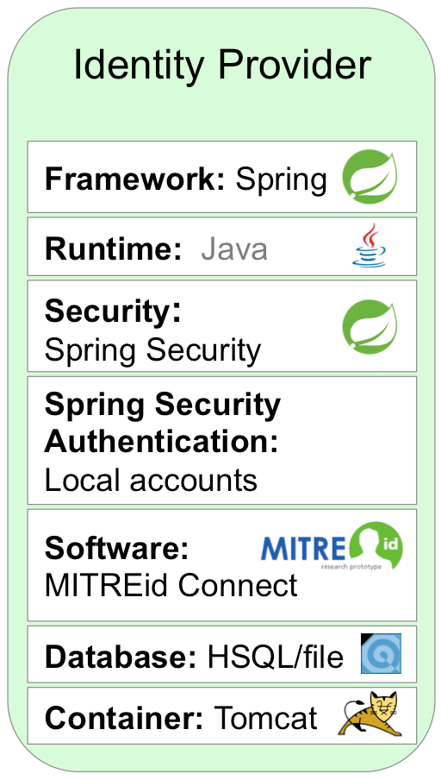
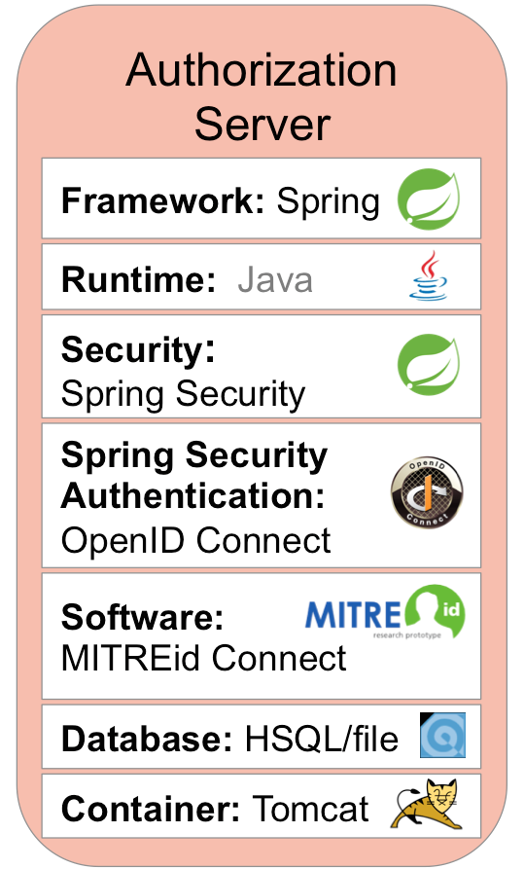
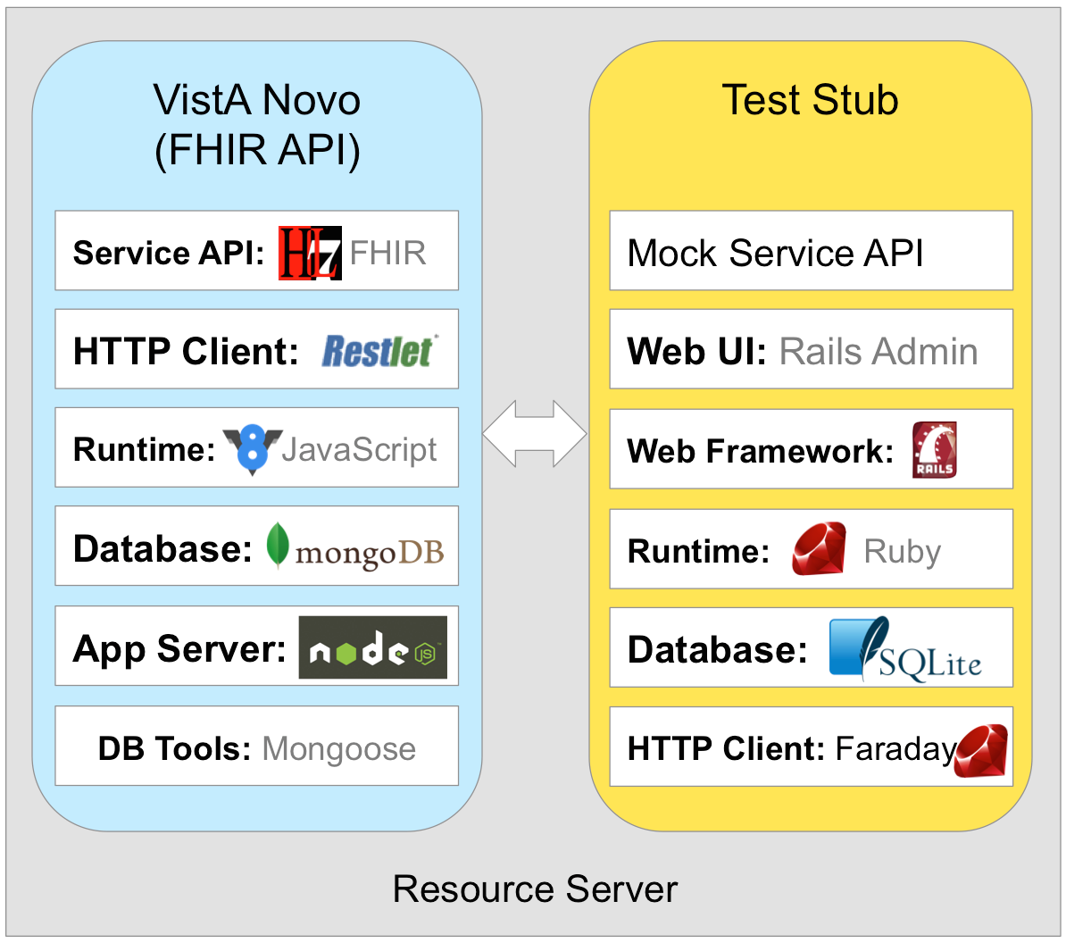
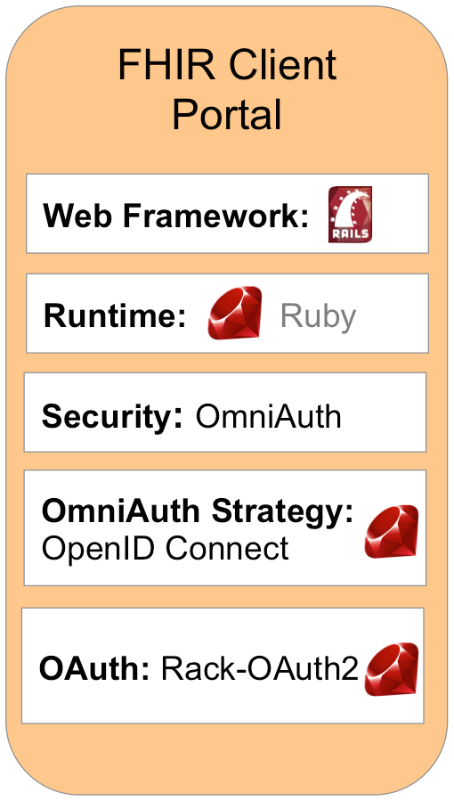
Pilot Architecture – Communications
JSON
HTML / JSON
JSON
HTML
HTML / JSON
HTML / JSON
FHIR

Slide 44
Pilot Implementation Findings
The profiles can be implemented successfully
The profiles can enhance the baseline security of OAuth & OpenID Connect implementations
There are functionality gaps in libraries on almost all platforms
Particularly in client authentication functionality
Documentation is also lacking
UMA could make implementation of these use cases much more practical
Provide a mechanism for cross-domain authorization of users
Facilitate discovery and linkage of authorization servers to resources across domains

Slide 45
Pilot Implementation Findings, Continued
FHIR enables fine-grained requests for individual resources, at the expense of increased “chattiness”
Composing a “patient overview” page with different types of information may require several FHIR requests
Caching of tokens and introspection responses helps limit the additional overhead of multiple requests
Dynamic discovery & registration of clients is technically feasible, but policy questions loom
A “vet everything” policy likely can’t keep up with user demand & mobile app update frequency
Enabling users to choose their own clients gives them additional freedom, but it comes with responsibility for their choices
Communications and user education can help address this

Slide 46
Why VA should move forward with the profiles
REST is pervasive, and is the future
Already the dominant architecture of the web
HL7 and the health community are embracing it (see FHIR)
Supports integration with mobile and lightweight clients
Many organizations using REST for internal interfaces as well
Common profiles support integration with mission partners
A common scheme is needed to guarantee baseline security and interoperability
Defined profiles make it easy to bring new partners on board
A standard approach to REST security is needed within VA
Multiple REST interfaces in the works (kiosks, mobile, etc.)
Without a standard approach, projects will implement their own (likely incompatible) security schemes, requiring re-engineering to integrate them down the road

Slide 47
Next Steps
Outreach and Use of REST security profiles
MITRE is reaching out to the VA, health, and government IT communities to:
Socialize the profiles, validate their usefulness and identify gaps
Seek consensus to work toward a common approach
Profiles are only useful to the extent they are adopted
Desire general healthcare or government information sharing profiles
Ideally, transition profiles to a standards body for community adoption
Engage on Security Profiles as One Component of Information Exchange
Standardization is also needed at the data and messaging layers
Complementary efforts such as FHIR can provide components for healthcare
Separating security and data concerns makes architectural sense
Engage with open source library developers
Contribute code to add support for profiles, facilitating adoption
Notes:
Actively trying to get sw to support the profiles – if a library supports it, it’s much easier to implement

Slide 48
Steps towards VA Adoption of the Profiles
Identify projects for pilot adoption
Multiple RESTful interface projects currently in the works
Develop requirements and plan for technical implementation
Identify integration points – existing IAM infrastructure, SOAP back-end services, etc.
Architect the required services (authorization servers, OpenID Connect providers, client components) and identify service providers
Develop documentation and resources for service consumers (client developers, relying parties)
Continue outreach with partners
Push for broader adoption to maximize interoperability
Work with standards bodies (HL7 Argonaut project, OIF HEART working group) to foster a common approach
Participate in public pilots to refine approach with real-world deployment experience

Slide 49
Potential future work
Address the elements not shown in the demo:
How to securely bind an identity at the user’s chosen identity provider to a medical record
How users can define access policies granting other people access to their data across domains through an UMA profile
Conduct security testing on pilot implementation to identify any weaknesses

Slide 50
Connections to Related Efforts
Privacy on FHIR (PoF)
Set of HIMSS 2015 demonstrations to show how to connect components in a patient-driven way
MITRE coordinated with VA PoF Team Lead to share draft profiles with PoF team
MITRE team members participating in planning
SMART on FHIR
Drop-in capability to enable FHIR in hospital environments
Uses several of the same components
http://docs.smartplatforms.org/
Argonaut
HL7 initiative to advance FHIR adoption by developing a first-generation FHIR API
Specific focus on security – reviewing SMART on FHIR’s use of OAuth and OpenID Connect with the ultimate goal of creating an HL7 specification for RESTful security
HEART Working Group
OpenID Foundation working group for health-related standards
Profiles have been offered as starting point documents
MITRE team members participating in founding the group
http://openid.net/wg/heart/
Healthcare Services Platform Consortium (HSPC)
A Vendor Agnostic Healthcare Enterprise/Vendor/Venture Partnership
MITRE shared publicly released profiles for consideration in pilot demonstrations
http://healthcaresoa.org/

Slide 51
Standards Organizations Related to This Effort
Organization | Notes
Internet Engineering Task Force (IETF) | Maintains OAuth 2.0 and related standards, in addition to core internet standards (TCP, HTTP, DNS, NTP, TLS, BGP, and many more)
OpenID Foundation (OIDF) | Maintains OpenID Connect; potential home for an effort to create profiles of OAuth and OpenID Connect for healthcare use
Kantara Initiative | Developing the UMA standard; also administers a trust framework and hosts numerous working groups
Identity, Credential, and Access Management Subcommittee (ICAMSC) | Runs the Federal ICAM (FICAM) program, which writes guidance for federal government ICAM implementation – interested in creating FICAM profiles of OAuth and OpenID Connect; runs the FICAM Trust Framework program, streamlining government use of commercial identity providers
National Institute of Standards and Technology (NIST) | Publishes standards and technical guidance for federal IT programs; works with OMB, FICAM, and others to define security and other requirements
Health Level 7 (HL7) | Maintain Fast Healthcare Interoperability Resources (FHIR) and many other health care standards, including ones concerning security and patient privacy

Slide 52
Want to help?
Read the profiles and guidance documents
Available on GitHub: http://secure-restful-interface-profile.github.io/pages/
Do the profiles meet your requirements for security and usability?
Are they applicable to your use cases?
What is missing?
Engage with Standards Bodies
Talk to the people who define standards for your community (NIST / FICAM / industry groups)
Ask about efforts to profile REST security standards
Offer these profiles as a starting point for standardization work
Engage with Software Vendors
Does your Web Access Management solution support OAuth or OpenID Connect?
Does it support the security measures in the profiles (e.g., signed JWTs for tokens and client authentication)?

Slide 53
For More Information
Secure RESTful Interface Profile page includes links to:
OAuth 2.0 and OpenID 1.0 profiles
Open source pilot demonstration code on GitHub site
http://secure-restful-interface-profile.github.io/pages/
OpenID Connect HEART Working Group
Intends to harmonize and develop a set of privacy and security specifications that enable an individual to control the authorization of access to RESTful health-related data sharing APIs, and to facilitate the development of interoperable implementations of these specifications by others
http://openid.net/wg/heart/

Slide 54
Backup Slides

Slide 55

























Who uses RESTful APIs?
Source: http://www.programmableweb.com/

Slide 56
Task Scope
Transport Security
Authentication
Authorization
API Design & Content
Not In Scope
In Scope
API content and messaging are not in scope
REST APIs such as HL7 FHIR* do not (and should not) dictate particular security mechanisms
Security elements can be layered over many different APIs serving different kinds of use cases
* Health Level 7 Fast Healthcare Interoperability Resources: http://www.hl7.org/implement/standards/fhir/

Slide 57
Open Security Standards for RESTful Interfaces
A stack of interrelated protocols in wide use on the web can help meet security requirements for RESTful interfaces:
UMA (User-Managed Access)
OpenID Connect (Federated Authentication)
OAuth (Authorization)
JWT (Secure Tokens)
Dependency
JOSE
(Signed & Encrypted Data)
TLS (Secure Transport)
JWK
JWS
JWE
JWA
Acronyms:
TLS: Transport Layer Security
JSON: JavaScript Object Notation
JWK: JSON Web Key
JWS: JSON Web Signature
JWE: JSON Web Encryption
JWA: JSON Web Algorithms
JOSE: JSON Object Signatures & Encryption
JWT: JSON Web Tokens

Slide 58
Information Interoperability Alignment Framework
Data
Information Exchange
1. Information Model
Security
Models of objects and relationships
6. Authentication
2. Terminology Models
Vocabulary sets and coding systems
Identity of the system user
3. Wire Format
7. Authorization
Transport
Producing System
Format of data in motion
Consuming System
End User
Quality of Service
End User
Receiver’s entitlement to patient data
4. Services Layer
Services used to perform the exchange
8. Privacy&Consent
5. Session Layer
Patient privacy rights and preferences
Middleware and messaging protocols
9. Data Integrity
IP and Network Layer
(assumed)
Protection of data in flight
Source: Healthcare Information Interoperability, Dr. Mark Kramer (MITRE), 2014

Slide 59

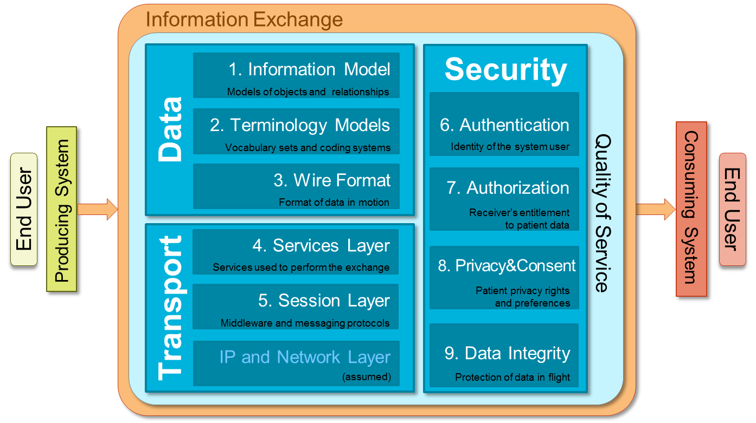
Components of RESTful Healthcare Interoperability
Secure RESTful Interface Profile
Provides profiles and security guidance for:
Client authorization using OAuth 2.0
Federated authentication using OpenID Connect 1.0
Provides logical models of conditions, medications, allergies, procedures, etc.
Works with any code set(s)
JSON and XML formats
REST API for Search,
Read, Create, Update, etc.
Stateless HTTP interactions
Transport Layer Security (TLS)
Provides transport encryption and integrity protection, as well as server and optional client authentication
User-Managed Access
Allows patients to define access control policies for their data

Slide 60
Notice
This technical data was produced for the U. S. Government under Contract Numbers VA791-P-0032, VA791-9-0042, VA798A-11-P-0015, VA118A-13-D-0037, and VA118A-15-D-0004 and is subject to Federal Acquisition Regulation Clause 52.227-14, Rights in Data – General, Alt. II (JUN 1987), Alt. III (JUN 1987) and Alt. IV (JUN 1987).
No other use other than that granted to the U. S. Government, or to those acting on behalf of the U. S. Government under that Clause is authorized without the express written permission of The MITRE Corporation.
For further information, please contact The MITRE Corporation, Contracts Office, 7515 Colshire Drive, McLean, VA 22102-7539, (703) 983-6000.
©2015 The MITRE Corporation. All rights reserved.

